Slide 1
String project
By: stoyan kolev, alexander dinev, simeon nikolov

Slide 2

Team members
Stoyan Kolev – Manager
SNKolev18@codingburgas.bg
Alexander Dinev – Developer
AGDinev18@codingburgas.bg
Simeon Nikolov – Designer
SRNikolov18@codingburgas.bg

Slide 3

IDEA OF THE PROJECT
We wanted to create a game, where the user is given a random word and he has to guess it by giving him a hint.

Slide 4

Problems with the project
We met difficulties with writing and reading information in/from the files. Also some minor bugs which we cleared really quickly.

Slide 5
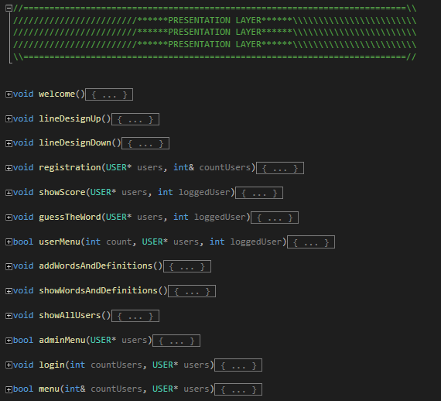
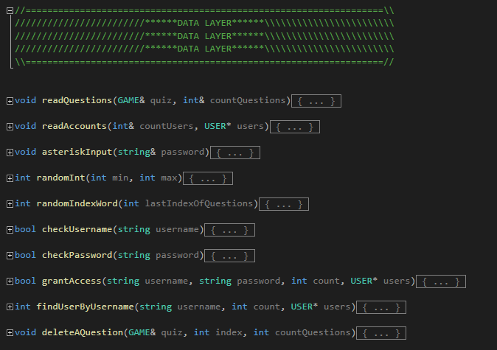
Part of The code

Slide 6






USED TECHNOLOGIES

Slide 7

Advantages and disadvantages of the program
The advantages of the program: You can play our game for free. Also it’s funny, relaxing and you can learn some unfamiliar words. It can be used in school for education.
The disadvantage of the program: The memory isn’t allocated dynamically

Slide 8

Future ideas
In the future we shall make a website from where you can play our game.
We can make some changes like adding different game modes.
Make the games longer to play.

Slide 9
LETS CONTINUE WITH THE CODE

Slide 10


Slide 11

Thank you for your attention

